Slide 1
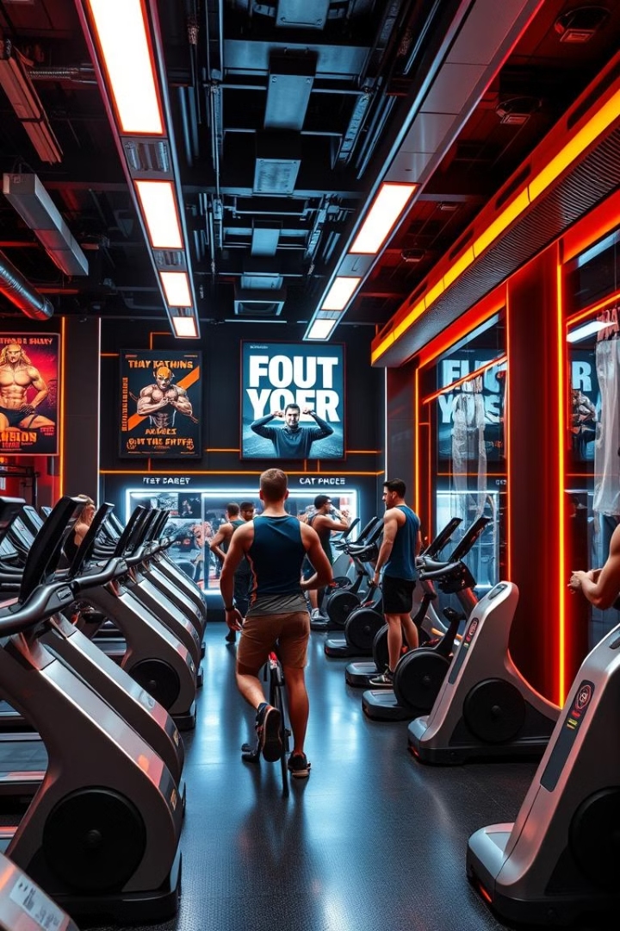

Gym Management System: Modernizing Operations
A modern solution to streamline gym operations, moving from manual cards to a database-driven system.
by K J

Slide 2



Gym Entity: Key Attributes
Name & Address
Phone Number
Unique identifiers for each gym location.
Contact information for members.

Slide 3
Member Entity: Personal Information
Unique ID
Personal Details
Primary key for member identification.
Last name, first name, address, date of birth, gender.

Slide 4

Session Entity: Sport and Schedule
Type of Sport
Schedule
Yoga, aerobics, weightlifting, etc.
Date, time, duration.
Capacity
Maximum of 20 members per session.

Slide 5

Coach Entity: Expertise and Details
1
Name
2
Age
3
Specialty
Last name, first name.
Experience level.
Expertise in specific sports.

Slide 6



Relationships: Gym & Members
Registration
Gym Details
Members register at a specific gym.
Capture gym name, address and contact information

Slide 7


Relationships: Sessions & Coaches
Session
1
Coaches
Led by a maximum of two coaches.
Assign coaches to various sessions.
2

Slide 8

Next Steps: Database Implementation
1
Design
Finalize ER model and database schema.
2
Development
Implement the database and application.
3
Deployment
Roll out the new system across gyms.

